Slide 1
Welcome to
Year Four!
We have had a great start.

Slide 2
Year Four Team
Teachers
Mr. Stother - 4S
Mrs Hill-Cornwell - 4S
Mrs Sheehan – 4S
Miss Drummond - 4D
Miss Price - 4P
Learning Support Staff
Mrs Dasgupta
Mrs Nawaz
Mrs Trew

Slide 3
Year 4
After lock-down, every day is important!
By Year 4 children have completed over half of their Primary school education.
In Year 4 we teach the skills children need to be successful in Years 5 and 6.
Year 4 is the only Year group where swimming – a real life skill – is taught.

Slide 4
Attendance
Schools closed again last year. Children have missed learning.
It is more important than ever that children attend school daily.
We are teaching a full curriculum which also allows children to catch-up lost grounds. They can only catch-up if they are in school!
No holidays in school time, please!
Lateness is also absence! A child who is 5 minutes late every day misses the equivalent of nearly 12 days.
Gates are open 8:35 – 8:50 – there are no excuses for lateness.

Slide 5
Attendance
Even if children feel a little unwell, they can come to school unless:
They have been sick or had diarrhoea or vomiting in the last 24 hours.
They are showing symptoms of COVID-19.
High temperature – 37.8ºC or above.
A new, persistent cough.
Loss of taste or smell.
If they have COVID-19 symptoms, then you need to isolate and get PCR tested.

Slide 6
Uniform
Children need to come to school in correct school uniform with black shoes.
Uniform includes PE kit! This should be clearly labelled with the child’s name.
Notes:
Label Jumpers!

Slide 7
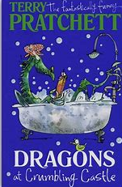
English
Reading
We are currently reading the story Dragons at Crumbling Castle. The children have great thoughts and ideas about the story already. You can support your child by reading information about explorers and how carpets are made.
Writing
In Year Four the children focus on using the following in writing:
Fronted adverbials
Expanded noun phrases
Apostrophes for plural possession
Accurate speech punctuation
Write paragraphs around a theme

Slide 8
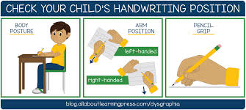
Handwriting
In Year Four we expect all children to join their handwriting.
Joined handwriting helps with spelling because the joins have a particular flow.
We teach handwriting every Tuesday morning.
When the children arrive at school they practise letter formations and joins.

Slide 9
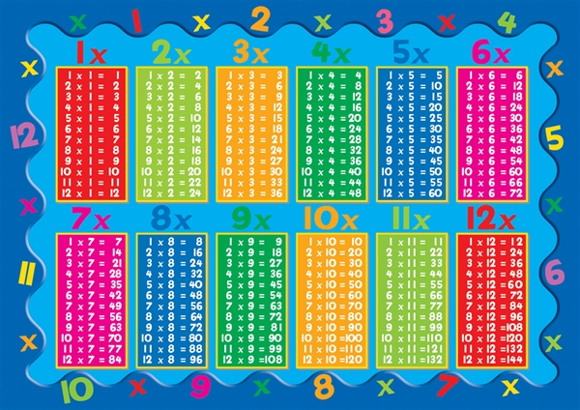
Maths
We follow a maths mastery approach in our Maths lessons. This involves using practical and visuals to understand concepts.
We use technology to help practise the recall of number facts for multiplication and division.
Invest your time in sitting with your child and listening to their explanations about their maths work. As part of our maths homework we will send home problem solving and reasoning maths challenges.
At the end of Year Four, the children will be sitting the National Multiplication Check.
They need to know their multiplication and division facts for up to 12 x 12 quickly and fluently.
Please practise these at home with your child because it enables them to do other mathematical questions quickly and efficiently.

Slide 10
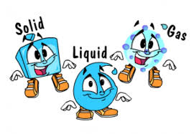
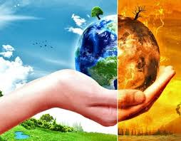
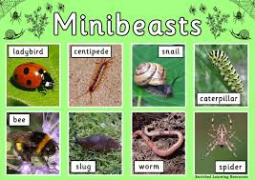
Science
Our science topics this year will include:
Teeth and digestion
States of matter
Sound
Living things and their habitats
Our changing world
Notes:
Chat with the children about these topics. Encourage them to use the vocabulary in the knowledge organisers.

Slide 11
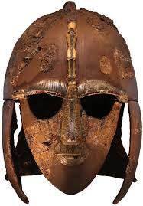
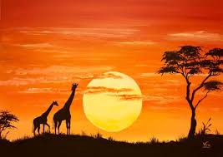
Humanities
Where possible, we link our experiences and writing to Science, History or Geography.
Our Humanities topics include: Romans, Anglo-Saxons, comparing Italy and the UK and Mountains.
Some of our experiences include: Roman Day, African story telling, Greatmoor Recycling Centre and working with the Chiltern Rangers
The cost of the visits or outings are approximately £10 per term, however it is possible to pay the full £30 and this will cover the cost of all visits/outings for the year.

Slide 12
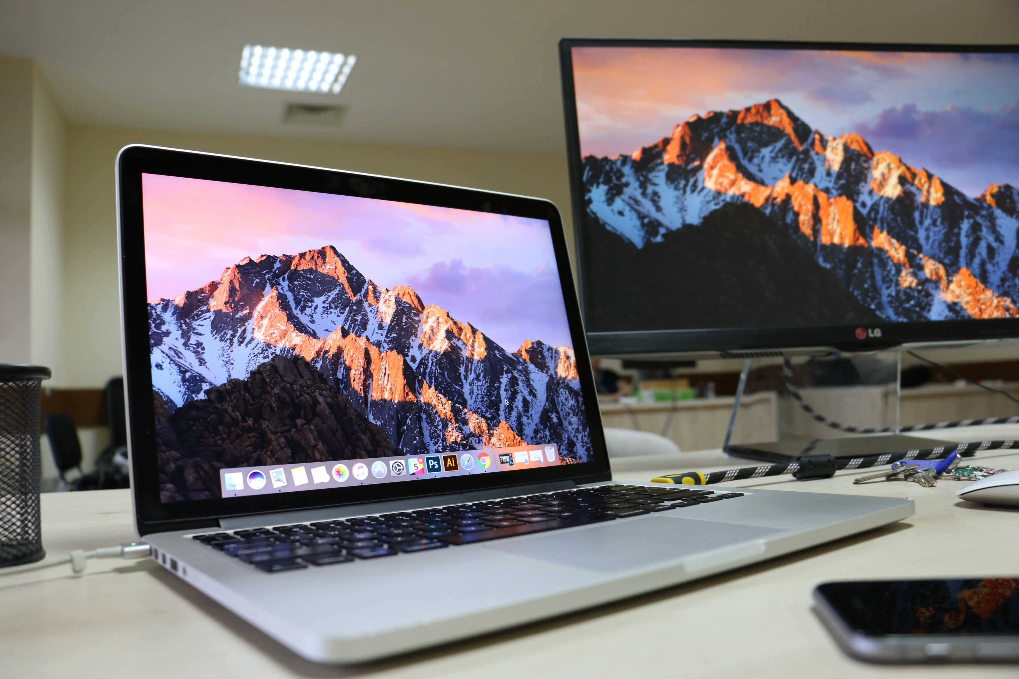
Computing
We cover six Computing units this year.
These include:
Scratch – learning the basics of coding and programming,
Website design,
Data handling – making and using spreadsheets.
We also continue to teach the children about Internet Safety – PLEASE be aware of what your children are looking at and playing online when at home.

Slide 13
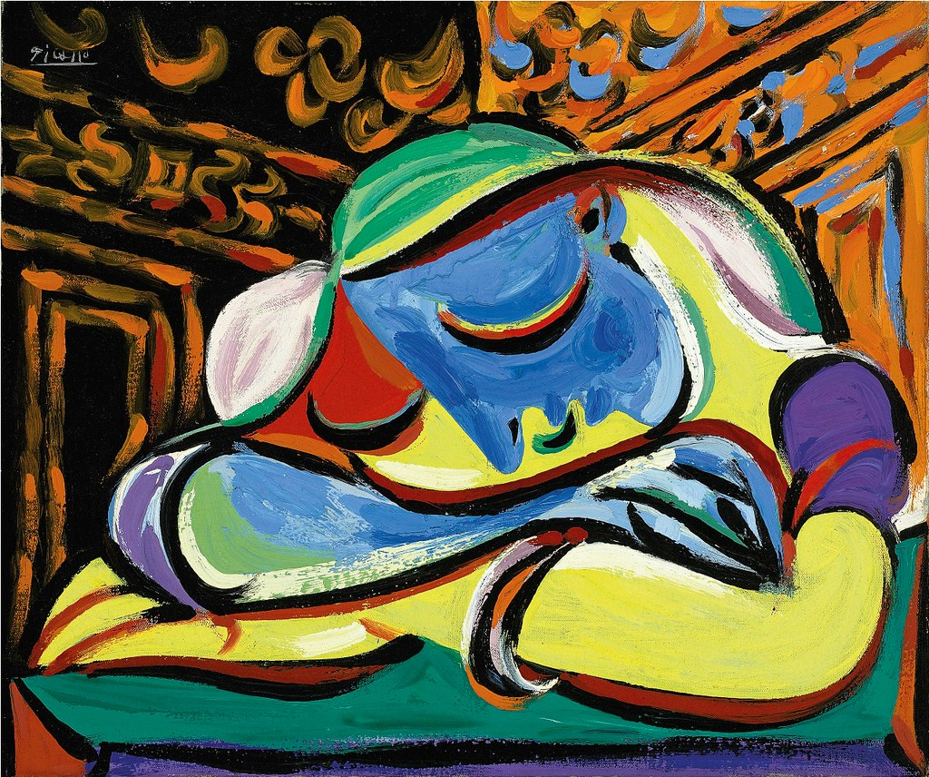
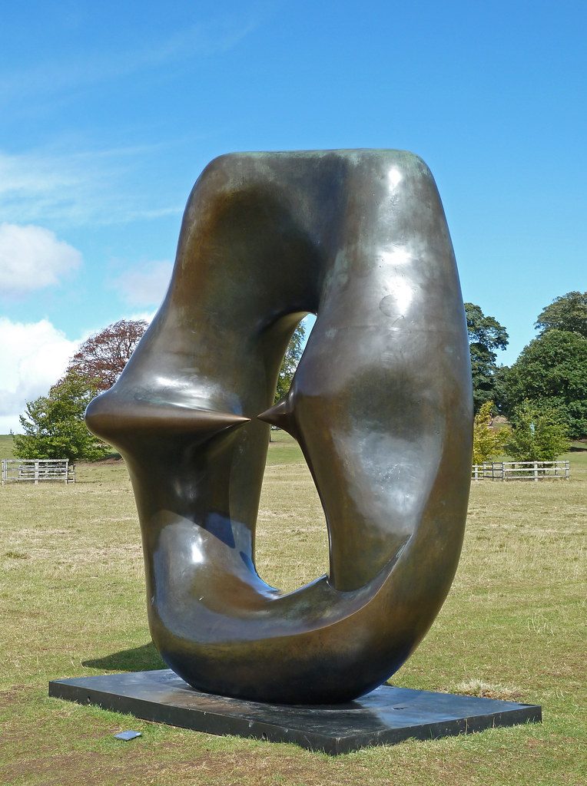
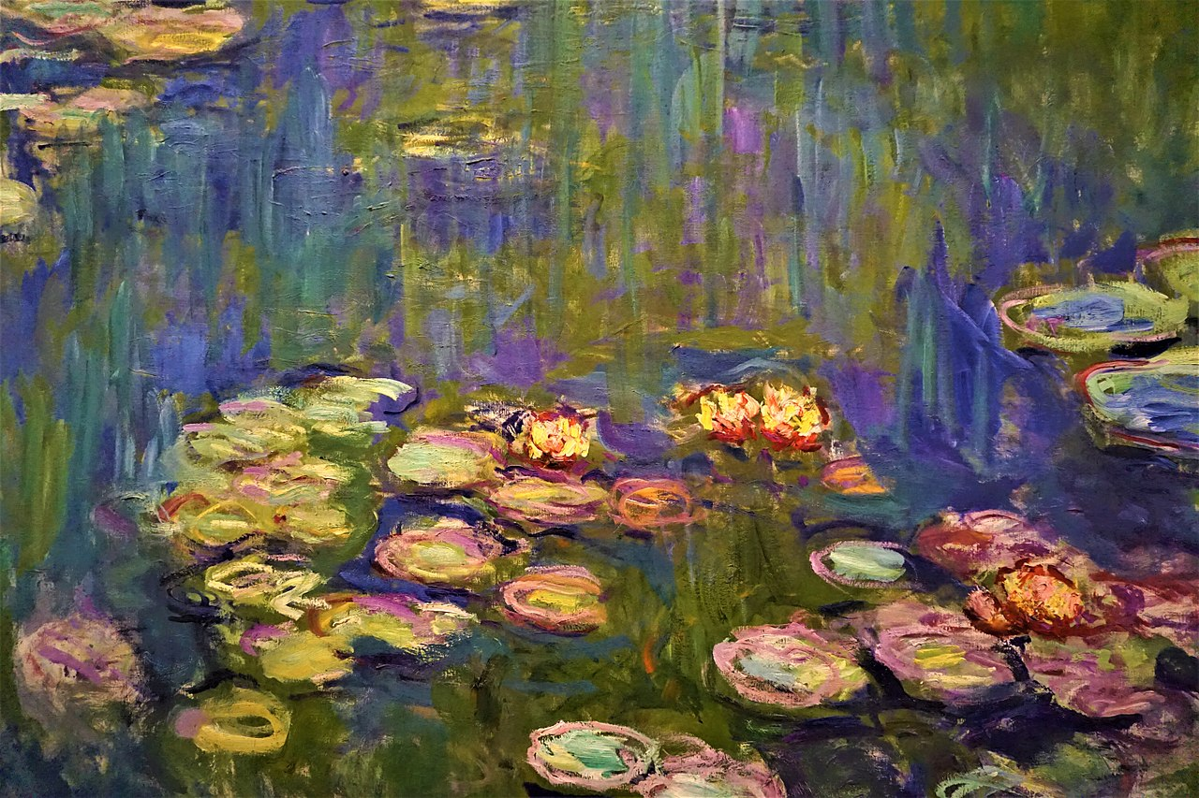
Art & D&T
Art and D.T. are each taught every other half term.
We will be learning about Picasso and Monet, in Art, studying their unique styles and producing work in imitation of these styles. Later on in the year, we will also be studying the sculpture of Henry Moore.
In DT, children will be making Italian pizza and sewing, as well as making a cool box for the summer.
This Photo by Unknown Author is licensed under CC BY

Slide 14
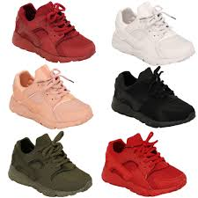
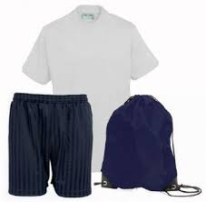
PE
Year 4 classes have PE twice a week (including swimming) so your child needs an appropriate PE kit in school every day.
For Summer, black shorts and a white t-shirt.
For Winter, black tracksuit bottoms, a t-shirt and a sweater.
Every piece of school uniform – including PE kits – should be clearly labelled with the child’s name.
Please ensure they have sturdy trainers.

Slide 15
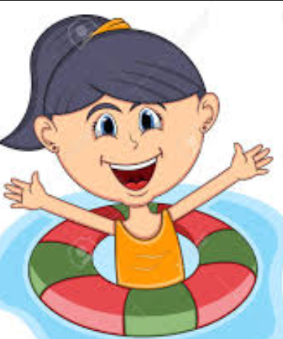
Swimming
Swimming lessons started on Monday 13th September for 4D and half of 4S.
Each class will have 11 x 1 hour lessons.
Children will be back at school to be collected at the normal time.

Slide 16
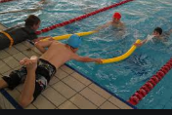
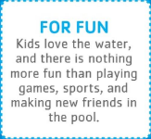
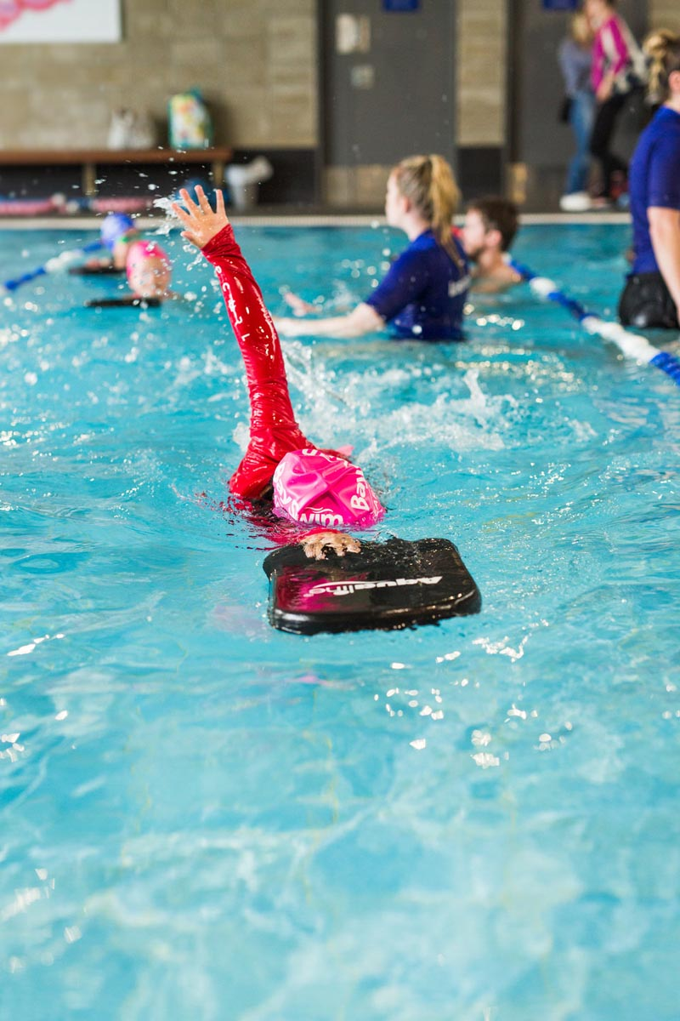
Why do we need to learn to swim?

Slide 17
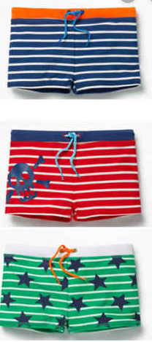
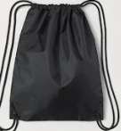
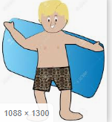
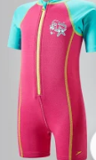
Swimming
What you need:
A towel
Bag
Swimming trunks – or close-fitting shorts. Board shorts are not acceptable!
Hair tied back in a pony tail or plait.
One piece Swimsuit
Bag
A towel
All earrings need to be removed before coming to school on a Monday.

Slide 18
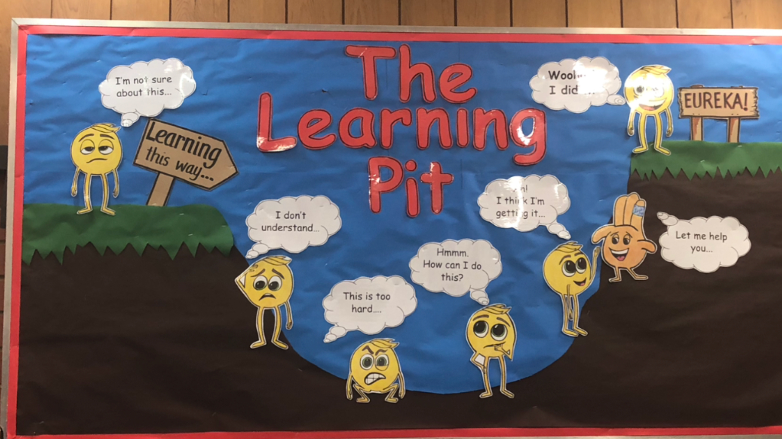
Growth Mindset
We encourage children to become successful independent learners by changing their mindset.
Positive work ethic
Can do attitude
Can’t do it yet
This links to our focus on metacognition – where children are encouraged to ‘think about thinking’ and reflect on their own learning.

Slide 19
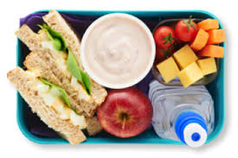
Lunches
Remember to complete your child’s lunch order on Parent Pay by Wednesday for the following week.
Please ensure your child has a healthy and balanced lunch.
All children need a water bottle with sports lid. Drinks should be water, not squash or juice.
If you are not sure whether you are eligible for free school meals, please complete an application form (speak to the office).

Slide 20
Homework
It’s all changed!
Children will receive their maths and SPaG homework every day on Google Classroom.
Reading also forms part of daily homework and should be written in the child’s reading record and signed by an adult.
All children have a school email address and logon and have been shown how to access the homework.
School email addresses are for school use only!
Please do not change passwords.

Slide 21
Homework
Children need to complete the homework for maths and Spag and hand it in online.
Please READ everyday with your child, discuss the story and ask questions.
Free-reading books have been chosen by the children. This is read for pleasure at home or at school, but it is important that they bring this book to school every day.
Encourage children to be responsible - Lost or damaged reading books will incur a cost of £5.00 according to school policy.

Slide 22
Things to do at home…
Support your child with their daily reading, spelling and maths homework.
Sign their record and send it into school every day.
Talk to your child about their school day.
Practise Times Table Rock Stars – we have the Government MTC in summer term!

Slide 23
Talk to us!
We have a shared interest – your child!
If you have questions or concerns, phone or email the Office. Your child’s class teacher will contact you at the earliest opportunity.
In the unlikely event that this does not achieve what you hoped, phone or email the Office to arrange to speak to Mr Stother as Year Leader.
We will listen!

Slide 24
Thank you for attending and listening!
Questions?

