Slide 1
Welcome to Year 6
Monday 11th September
Notes:
JB

Slide 2
Year 6 Staff
Class Teachers
Support Staff
  Miss Burrell (year lead)
  Miss Chandler
  Mrs Sheehan
  Miss Wilson (reading)
  Mrs Walker (writing & maths)
  Miss Mehmood
Notes:
JB

Slide 3
Attend everyday
Holidays outside of term time
Attendance
Missing even 5 minutes has a big impact (5 minutes everyday = 11.5 days per year)
Gates open at 8:35am
Lessons begin as soon as the children arrive
Notes:
JB

Slide 4
Secondary School Open Evenings
Please arrange during evening sessions
Medical Appointments
Please make appointments outside of school hours
Breakfast and bedtime
Notes:
JB

Slide 5
Secondary School
11+ and School Selection
11+ Test
Completed this week
Opting out, in writing
Apply for secondary schools online by 31/10
Results sent on the 13th October 2023
Schools allocated (first round) on the 1st March 2024
Notes:
JB

Slide 6
Year 6
An important year
Secondary school setting
GCSE options
A-Levels
Instilling a positive work ethic (even at a young age) is vital for success at a later age
Outcomes at end of KS2 dictate setting and options at GCSE and then into A-levels etc
Notes:
KS

Slide 7
Packed lunches
Healthy balance of food in lunch box. No nuts – we have allergies
Water bottle with sports lid (no juice and not frozen)
Notes:
DC

Slide 8
School uniform
Black shoes
PE kit (not mufti)
Notes:
DC

Slide 9
PE and Games
Monday
Please make sure PE kit (not mufti!) comes into school on a Monday and goes home for washing over the weekend
Thursday
Notes:
DC

Slide 10
Topics
Ancient Greeks
WW2
Local history
Rivers
North America
Range of artists
Light up signs
British cuisine (shepherd’s pie)
Keep an eye on the website and Facebook, they will be updated regularly.
Notes:
KS

Slide 11
Trips and Experiences
Ancient Greek Day
Hughenden Manor
North America Day
Freshwater Theatre
Permissionand payment on ParentPay
No more than £30 (less than £1 a week)
Will be cancelled if cost isn’t covered
Information to follow on residential
Notes:
KS

Slide 12
Walking home alone
Permission on Parent Pay
Walking home
If collecting, please ensure you collect promptly at 3:20pm.
Notes:
JB

Slide 13
Homework
Maths, SPAG and spelling homework posted online
MathShed and TTRS
SPAG
Spellings
Reading
Reading and maths signed in journal
Notes:
DC

Slide 14
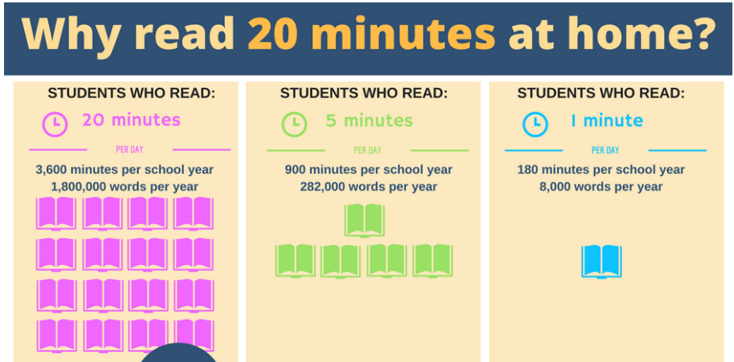
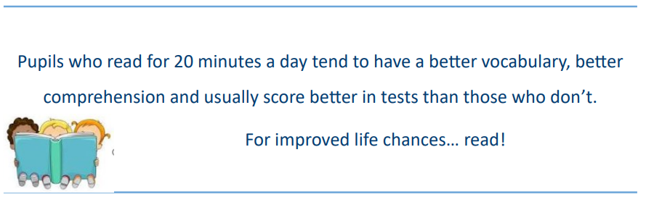
Notes:
DC

Slide 15
SATs
Take place w/c 13th May
Date | Test
Monday 13th May 2024 | Grammar & Punctuation test - 45 minutes Spelling Test - 20 minutes
Tuesday 14th May 2024 | English Reading Test - 60 minutes
Weds 15th May 2024 | Mathematics Arithmetic (Paper 1) - 30 minutes Mathematics Reasoning (Paper 2) - 40 minutes
Thurs 16th May 2024 | Mathematics Reasoning (Paper 3) - 40 minutes
Notes:
JB

Slide 16
Booster Classes
A letter will be sent with full details
Days to be decided
Spring term
Notes:
JB

Slide 17
Changes to contact details
  Change of address
  Email address
  Change of telephone numbers
  PLEASE let the office know ASAP
Notes:
KS

Slide 18
Any thing you wish to discuss
Speak to Class teacher
Speak to Year Leader
Please call the office to arrange.
Notes:
KS

