Slide 1
Welcome to Year 1 at Castlefield School

Slide 2
Teaching Staff
Year Leader- Miss Sutcliffe
Miss Avery- 1A
Miss Stevens- 1S
Mrs Vincent – 1V

Slide 3
General reminders
Children need to come to school in their school uniform with black shoes.
Arriving promptly at 8.50am ready for handwriting.
Being even 5 minutes late really adds up and children miss out on valuable learning time.
Year 1 pick up time is at 3:00pm and the gate close promptly at 3:10pm

Slide 4
Attendance
Children must attend school every day, even if they feel a little unwell – we will send home if too ill.
- UNLESS COVID19 symptoms are present.
You must isolate and get tested!
Absences mean children miss out on important learning and quickly fall behind.
No holidays in term time!
Notes:
LIsa

Slide 5
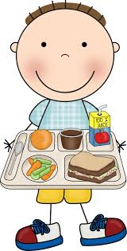
Lunches
A reminder that Universal Free school meals are free for children in Key Stage 1.
Remember to send your child’s lunch order form by Wednesday for the following week. If it is not back you child will not get a free school meal!
Please ensure your child has a healthy
and balanced lunch.
Children can bring in a water bottle with sports lid.
(not juice, not frozen)
Notes:
Paige

Slide 6
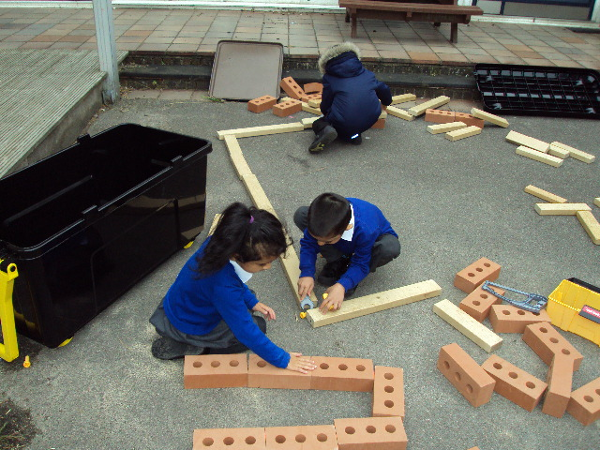
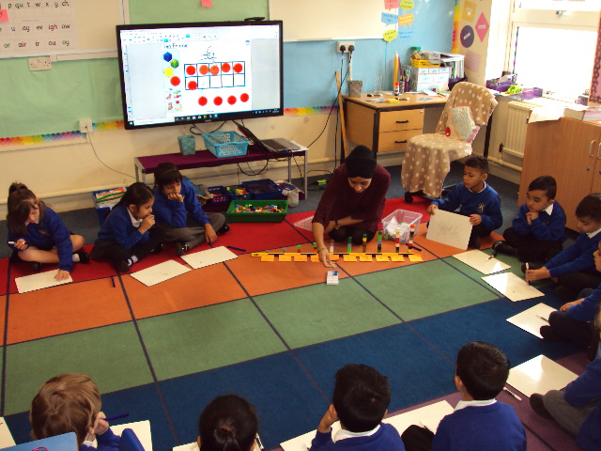
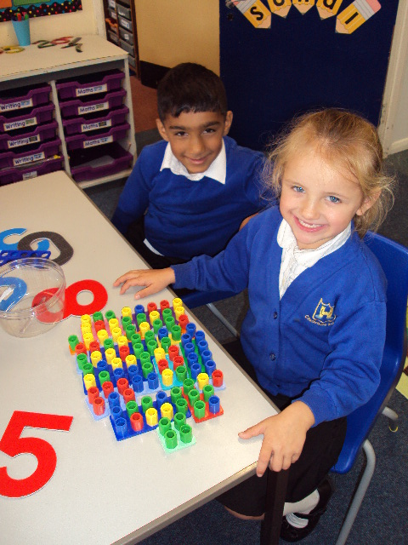
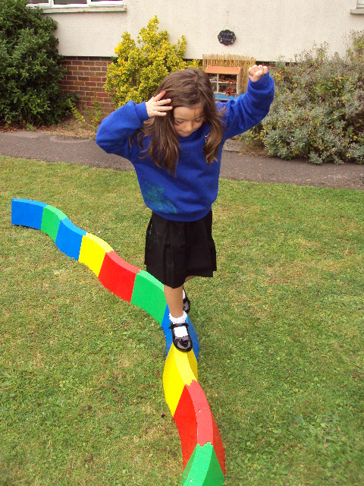
Transition
The Autumn term is a transition period in Year 1
Semi- structured mornings with a Reading, Writing and Maths lesson
Daily phonics
Use of the outdoor area
Notes:
prabhpreet

Slide 7
Reading
40 min Phonics lesson everyday
Children learn new sounds, read, spell and write everyday.
All Year 1 pupils will do the Statutory Phonics Screening check in the Summer term. This is made up of real words and nonsense words that the children have to read.
Children will bring home red and green words from their phonics lessons.
Notes:
Lisa

Slide 8
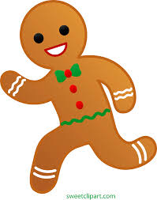
Writing
This term our theme is Marvellous Me and we are reading Silly Billy, The Gingerbread Man and Dandelion to name a few.
We will be having a Senses Day on Wednesday 14th October.
Notes:
Paige- can pay £30 at the beginning of year

Slide 9
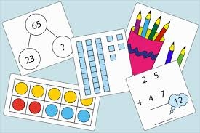
Maths
We follow a Maths Mastery approach in Year 1.
There is a greater emphasis in understanding and manipulating numbers rather than working with bigger numbers. Spend time in sitting with your child and listening to their explanations about their maths work.
Notes:
prabhpreet

Slide 10
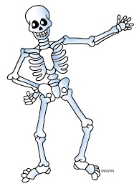
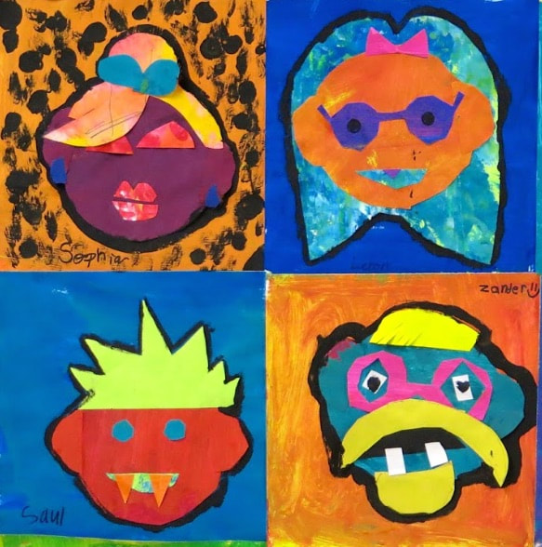
Recovery Curriculum
In Term 1 we are focusing on Reading, Writing and Maths, allowing children to form a foundation for future work in wider curriculum areas.
Children will take part in 2 PE lessons, Metacognition and Learning for Life lessons each week.
Notes:
Paige

Slide 11
Wider Curriculum
Topics and Themes for this year are:
Marvellous me
Magical Monsters
Superheroes
Who lives in this house?
Feet, Paws and Claws
Plant Power
Theme days and trips include:
Wendover Woods
Farm Visit
Superhero Day
Our trips and experiences will cost no more than £30 a year, this is less than £1 a week.
Notes:
Paige

Slide 12
PE
Your child needs an appropriate PE kit in school every day.
For indoor, black shorts and a white t-shirt.
For outdoor black tracksuit bottoms, a sweatshirt, socks and trainers. Seasonally appropriate please.
1A PE days are Tuesday and Wednesday
1S PE days are Tuesday Wednesday and Thursday
1V days are Wednesday and Thursday
Notes:
Lisa

Slide 13
Homework
Children will start to get their homework for the week every Monday.
They need to complete the named day for Maths and bring it in to show their teacher the next day.
READ everyday with your child,
discuss the story and ask questions. (We change reading books on Mondays, Wednesdays and Fridays)
Sign the Maths and Reading sections of your child’s Reading Journal EVERY DAY.
Soon, some homework will be going online and you will need to support your child with this.
Notes:
prabhpreet

Slide 14
Things to do at home
Support your child with their daily reading, spelling and maths homework.
Sign their record and send it into school everyday.
Talk to your child about their school day.
Notes:
Paige

Slide 15
Finally…
Any changes to phone numbers and addresses need to be given to the office.
If there are any problems during the year please contact the office to speak to a classroom teacher.
Thank you for coming.
Notes:
prabhpreet

