Slide 1
Green park, aston clinton
Monday17th June – Wednesday 19th JUne

Slide 2
For over 35 years, our transformative school trips have encouraged primary school pupils to build confidence and resilience by taking on fun challenges.
Each year over 175,000 young people visit Kingswood to experience exciting activities, from archery to zipwire, and they go home with so much more. They leave with the feeling that they can achieve their goals, and it’s wonderful to see the most uncertain pupils becoming the most enthusiastic.
We provide the perfect environment to develop positive mind-sets, improve wellbeing and encourage self-belief, plus there is always lots of laughter.
Every child will benefit from a Kingswood adventure. Character development is at the core of each Kingswood programme with a focus on confidence, resilience and life skills, which are delivered through a carefully designed mix of challenge, play and reflection.

Slide 3
Adventure course
Our most popular adventure, which gives you a diverse and pre-built activity programme delivering a balanced mix of outcomes across confidence, resilience and life skills. Our Adventure programme features a mix of daily challenging activities, educational and fun evening entertainment and dedicated time with one of our brilliant Course Directors to help children to engage in all aspects of the curriculum and reflect on their learning.

Slide 4
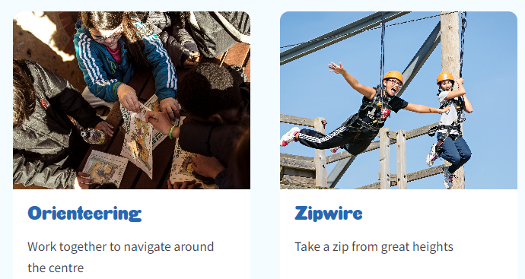


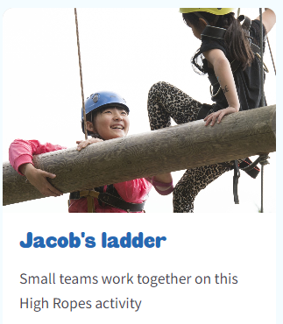
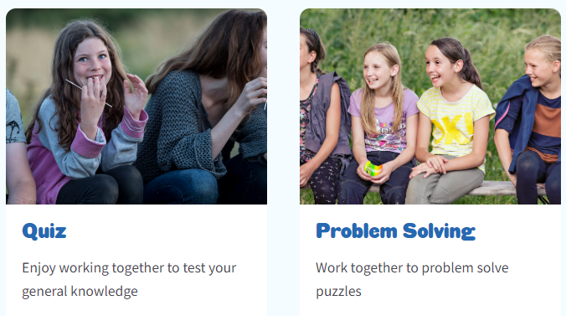

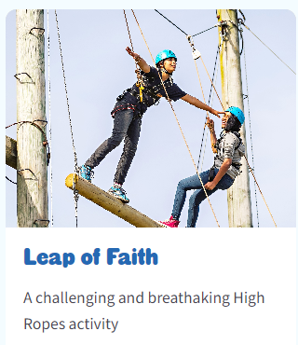
Examples of Activities – all run by qualified staff from Green Park

Slide 5
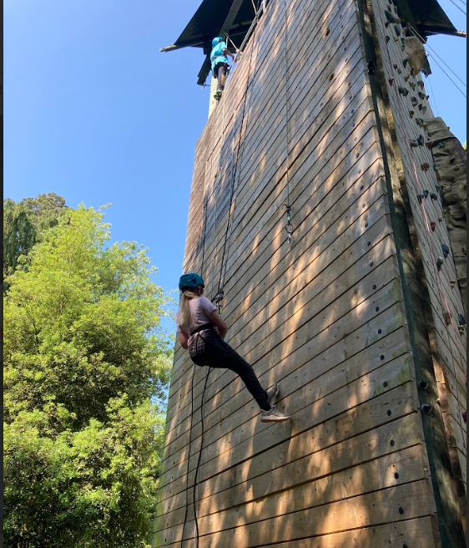
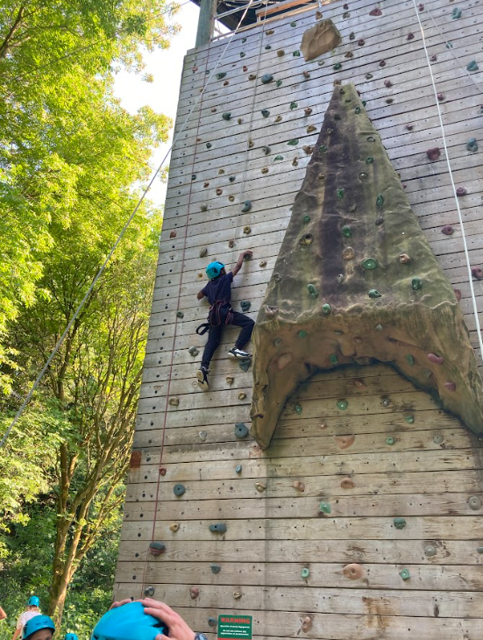
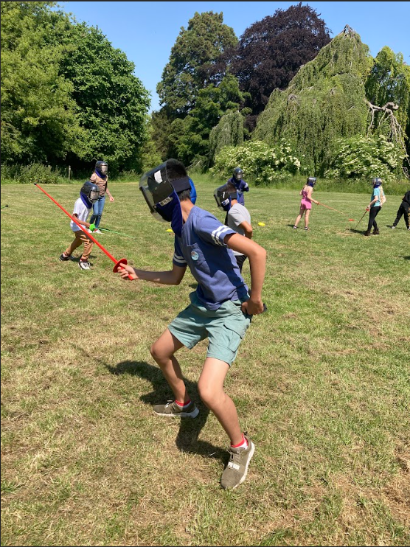
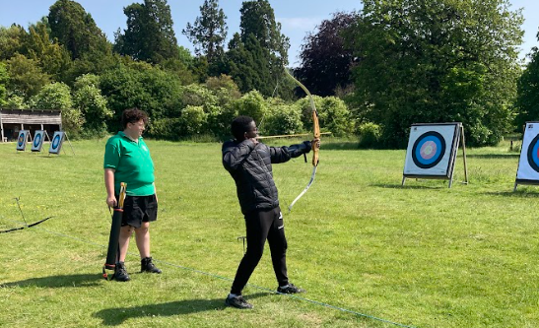
Reviews from last year’s students
“I had a blast. The stay was amazing and I learnt lots of new skills. I highly recommend it.” – Saaliha
“The residential was amazing. We got to do so many different activities such as climbing, archery and fencing.” – TW
“All the staff were so welcoming and fun.”- Evie
“The best experience at Castlefield School I have had. 10/10.” – Taha and Nicolas.

Slide 6
Accommodation
Children will stay in dorm rooms of 2-3 children.
Boys and girls will not share rooms or bathrooms.
All bedding is provided.

Slide 7
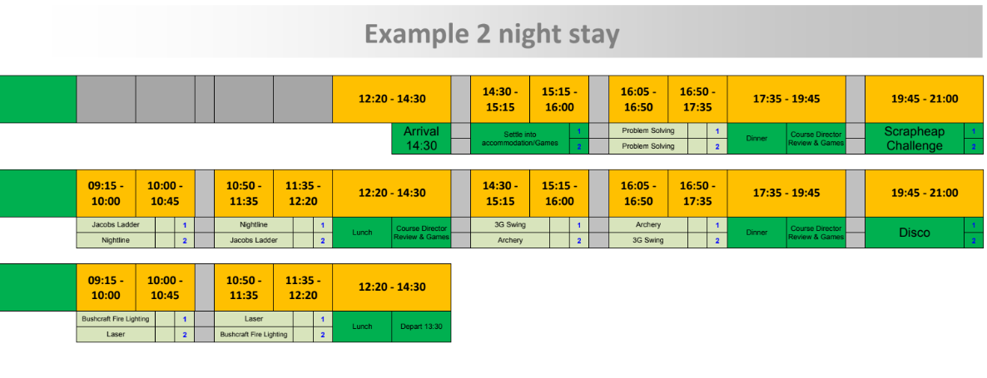
Example itinerary
We have booked an early arrival so we get an extra session of activities on the day we arrive.

Slide 8
Catering
All meals are catered for.
Vegetarian and Halal will be catered for and any other dietary needs.

Slide 9
PRICE
Once numbers are confirmed we will have a final figure should be around £300.
Price includes:
  all the amazing activities
  evening entertainment
  accommodation
  bedding
  food
  Coach
  Insurance
  Qualified staff

Slide 10
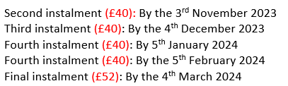
To secure place
There are only 20 spaces available on the trip.
To secure place on trip you will need to pay deposit of £70 on ParentPay by 22th September.
First come, first served basis
The rest of the payment can be paid in 5 instalments
We can also provide other payment plans to support you in paying.

