Slide 1
Woodrow High House
Wednesday 15th July 2026 – Friday 17th July 2026
Notes:
https://www.youtube.com/watch?v=628svmJ90Do

Slide 2


Slide 3


Slide 4


Slide 5


Slide 6


Slide 7


Slide 8


Slide 9
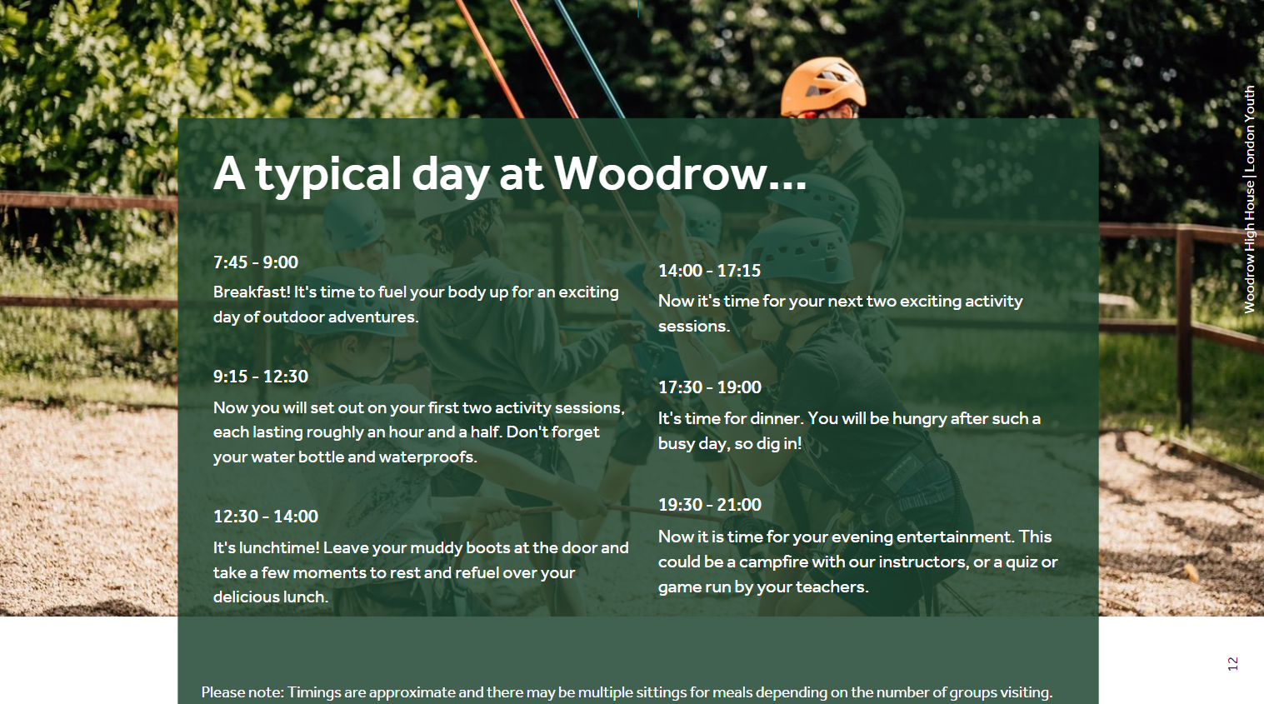

Slide 10
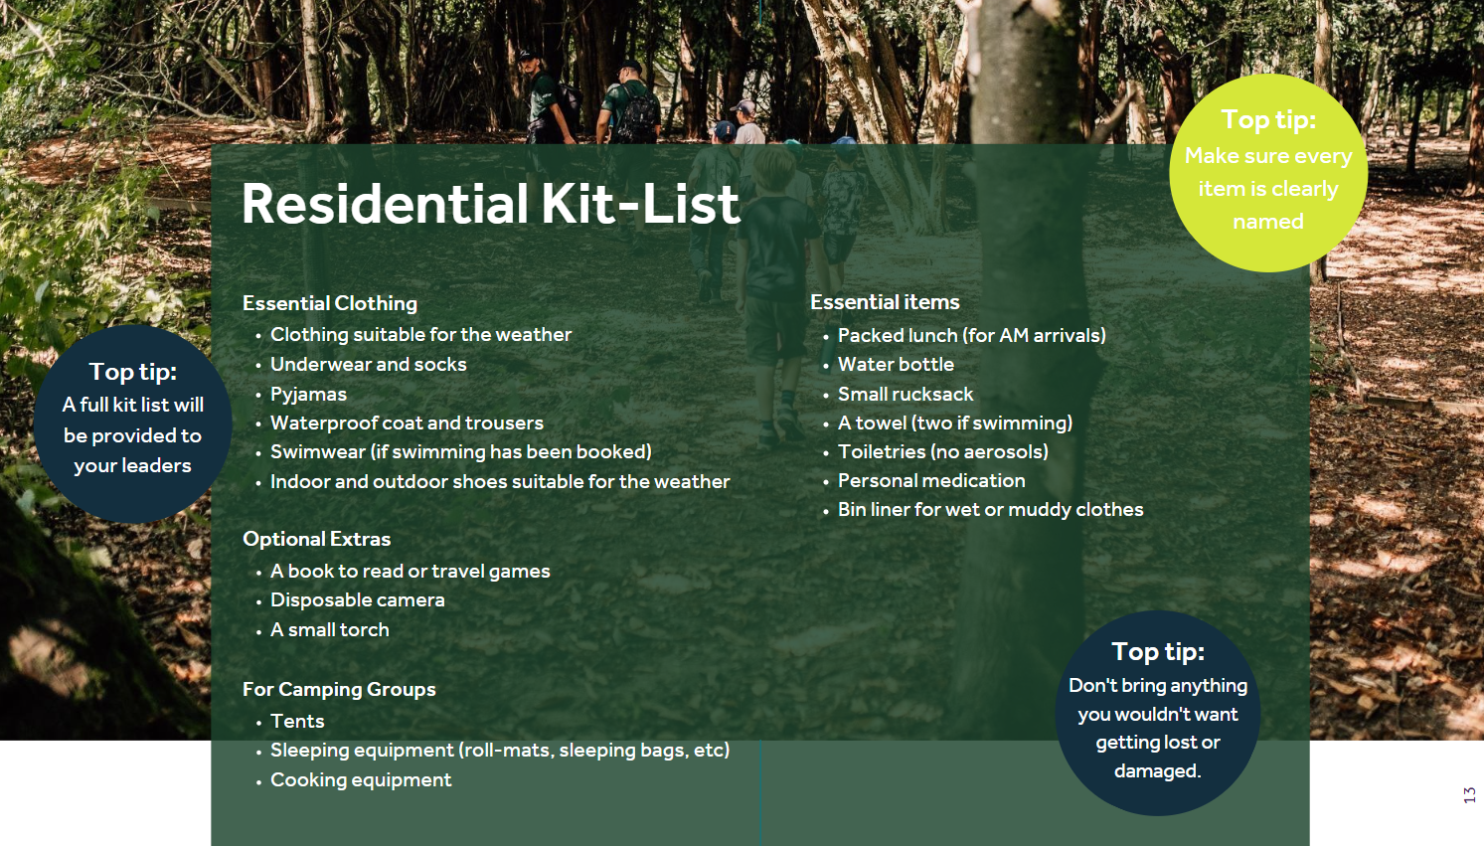

Slide 11


Slide 12
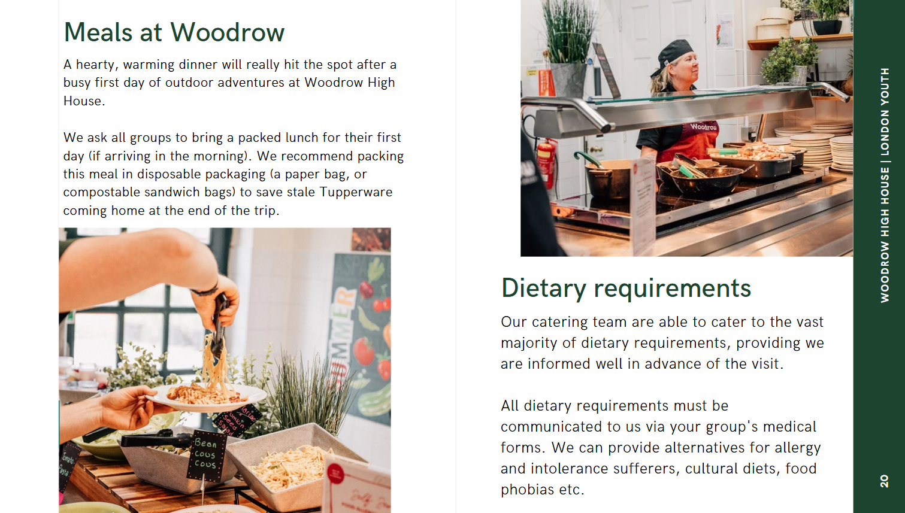

Slide 13


Slide 14
PRICE
Once numbers are confirmed we will have a final figure should be around £297.50.
Price includes:
  all the amazing activities
  evening entertainment
  accommodation
  bedding
  food
  Insurance
  Qualified staff

Slide 15
To secure place
There are 43 spaces available
To secure place on trip you will need to pay deposit of £89 on ParentPay by 15th September.
First come, first served basis
The rest of the payment can be paid in 5 instalments this will be sent out in the new academic year.
We can also provide other payment plans to support you in paying.

